Slide 1

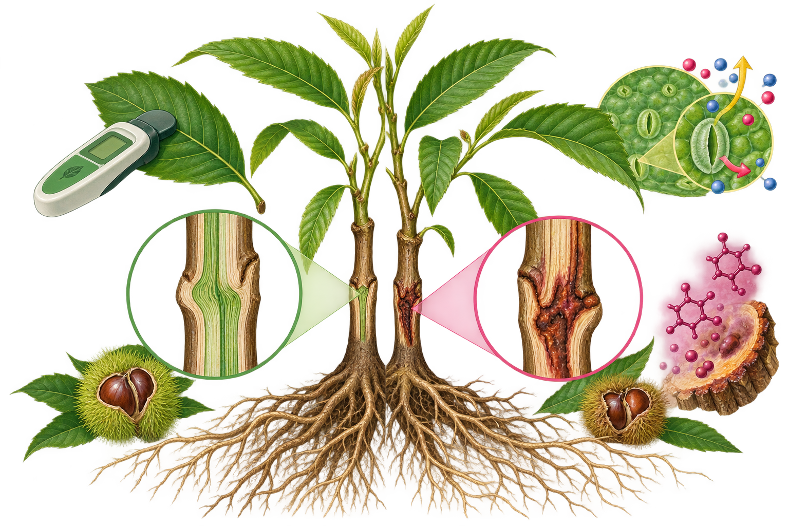
Early prediction of graft
incompatibility in chestnut
G. Gamba¹ · D. Donno¹ · G.L. Beccaro¹
¹ Department of Agricultural, Forest and Food Sciences (DISAFA), University of Torino, Italy
Chestnut R&D Center
COMPATIBLE
INCOMPATIBLE
PHYSIOLOGICAL
SIGNATURE
↓
Chlorophyll
content
↓
Stomatal
conductance
↑
Total phenols
at EVC
Combined monitoring
Physiology +
phytochemistry
TAKE-HOME MESSAGE
Lower chlorophyll and conductance, together with higher end-of-cycle phenols, distinguish incompatible graft combinations.
Notes:
Image-led example. The scientific body, take-home message and original illustration have been retained from the supplied PPTX. Titles and author block have been repositioned. All three listed authors share affiliation 1. The Chestnut R&D Center line is retained from the supplied template, not assigned as a separate numbered institution.
The published 2024 Acta Horticulturae author list has been retained (G. Gamba, D. Donno, G.L. Beccaro); the earlier conference submission has a different author list and has not been substituted.
[Sources]
- Supplied ICS2027_graphical_abstract_templates_REDESIGNED(1).pptx, slide 1: scientific illustration, brand motif, scientific body and institutional wording. The illustration is illustrative, not a research micrograph or experimental measurement.
- Gamba G., Donno D., Beccaro G.L. (2024), Study of the biochemical and physiological dynamics occurring during grafting: a further step towards the prediction of graft incompatibility in chestnut. Acta Horticulturae 1400, 205-210. DOI: 10.17660/ActaHortic.2024.1400.24. https://www.ishs.org/ishs-article/1400_24/
- Conference author-address cross-check: https://www.chestnutsymposium.com/files/get/53, pp. 1-2.
[/Sources]

Slide 2
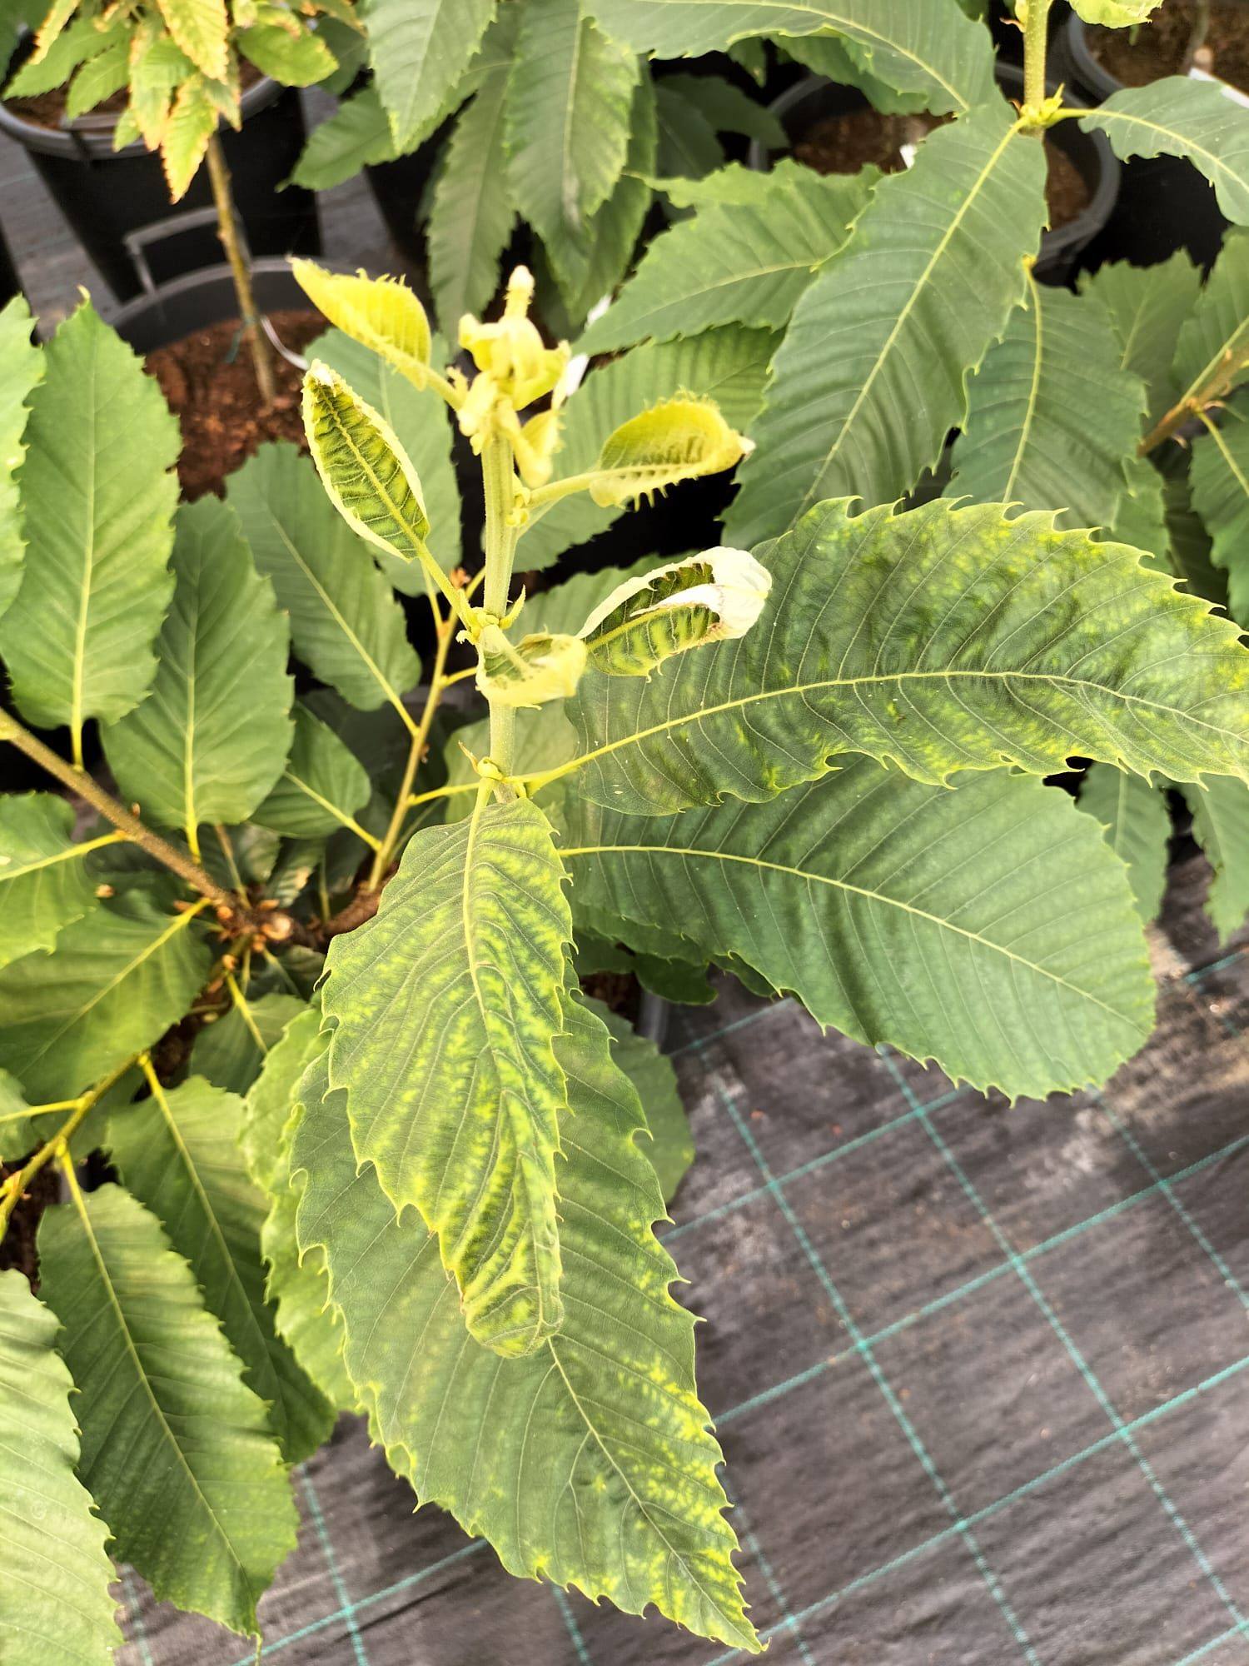
Chestnut mosaic virus:
transmission, latency and canopy symptoms
S. Murolo¹ · A. Marais² · Y. Brans³ · C. Faure² · G. Gamba⁴ · D. Torello Marinoni⁴
E. Tura⁵ · F. Latour³ · F. Carloni¹ · A. Minafra⁶ · M. Cardone⁵ · G.L. Beccaro⁴ · G. Romanazzi¹
¹ Università Politecnica delle Marche, Ancona, Italy
² INRAE · Université de Bordeaux, UMR BFP, France
³ CTIFL, Centre de Lanxade, Prigonrieux, France
⁴ University of Torino, DISAFA, Italy
⁵ CAV – Centro Attività Vivaistiche, Faenza, Italy
⁶ CNR, Institute for Sustainable Plant Protection, Bari, Italy
1
GRAFTING
2
LATENCY
ChMV is transmitted by grafting. Sensitive hybrids such as ‘Maraval’ can be used for wood indexing. Scions and buds should be collected from ChMV-free mother plants.
Molecular tests can detect ChMV in symptomless plants. Apparently healthy mother plants may carry the virus, so canopy observations should be complemented by molecular diagnosis.
3
STRESS
4
CANOPY
3
Temperature shifts and nutrient depletion may break viral latency and increase symptom severity. The response can vary with the viral variant and chestnut genotype.
Light and dark green patches may progress to blade deformation, curling and desiccation. Symptoms intensify from May to September; greater severity is associated with lower vigour and production.
TAKE-HOME MESSAGE
Molecular testing must include asymptomatic mother plants, because stress may reactivate symptoms and increase outbreak risk.
Notes:
Balanced graphical abstract: the four sections GRAFTING, LATENCY, STRESS and CANOPY are preserved, with a reduced original illustration and expanded paraphrases of the published abstract.
Full published author order restored. Affiliation numbering is editorial, assigned in order of first appearance, and matched using the original conference author/address list. 1 = UNIVPM; 2 = INRAE / University of Bordeaux, UMR BFP; 3 = CTIFL; 4 = University of Torino, DISAFA; 5 = CAV, Faenza; 6 = CNR-IPSP, Bari. Brans and Latour belong to CTIFL, and Tura and Cardone to CAV; they are not reassigned to INRAE or Torino. The spelling M. Cardone follows both the published author list and the conference abstract; it has not been silently replaced using a differently spelled current staff record.
[Sources]
- Supplied ICS2027_graphical_abstract_templates_REDESIGNED(1).pptx, slide 2: original illustrative image, branding, title, four-section structure and take-home message. Illustration is schematic, not experimental evidence.
- Murolo S., Marais A., Brans Y., Faure C., Gamba G., Torello Marinoni D., Tura E., Latour F., Carloni F., Minafra A., Cardone M., Beccaro G.L., Romanazzi G. (2024). Chestnut mosaic virus: grafting-transmissibility and the interference with plant canopy. Acta Horticulturae 1400, 117-124. DOI: 10.17660/ActaHortic.2024.1400.14. https://www.ishs.org/ishs-article/1400_14/
- Original conference abstract and author-address list, VII International Chestnut Symposium, Pests and Diseases, pp. 5-6: https://www.chestnutsymposium.com/files/get/51
- CAV name and Via Tebano 45 address: https://www.cavtebano.it/
[/Sources]

Slide 3
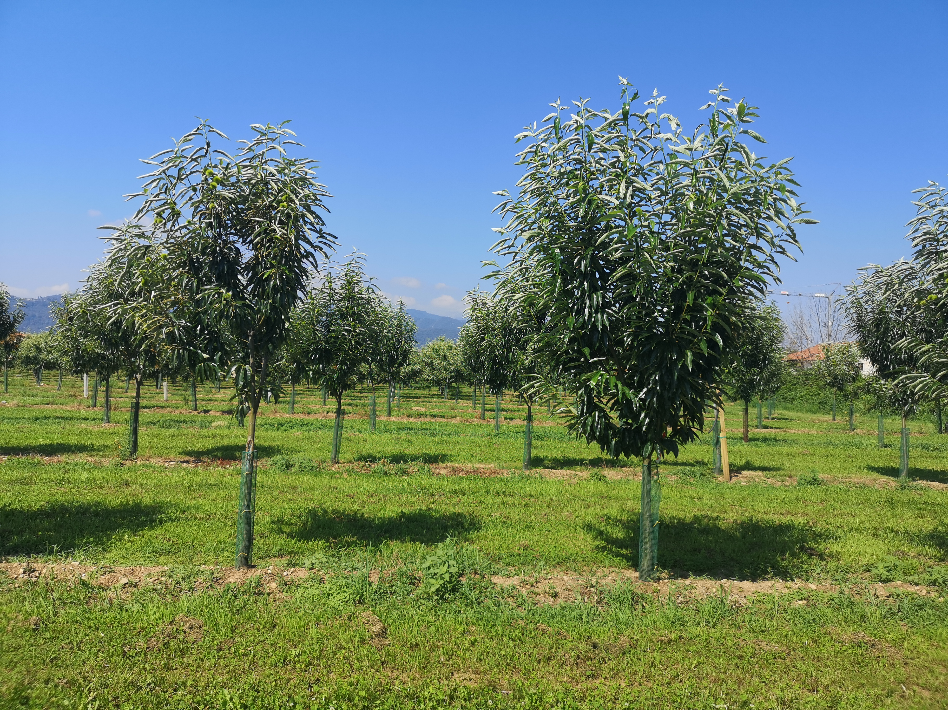
Resilient chestnut orchards
through precision farming and breeding
L. Rosso¹ · G. Gamba¹ · N. Valentini¹ · G.L. Beccaro¹ · D. Torello Marinoni¹
L. Comba¹ · A. Biglia¹ · A. Sopegno¹ · R. Botta¹
¹ Department of Agricultural, Forest and Food Sciences (DISAFA), University of Torino, Italy
Chestnut R&D Center
STUDY AIM
Two complementary routes
to orchard resilience
The study combines non-destructive tree monitoring and F1 progeny assessment. These complementary approaches aim to improve input efficiency and support the selection of cultivars adapted to biotic and abiotic stress.
PRECISION FARMING
BREEDING
NON-DESTRUCTIVE SENSING
130-TREE F1 PROGENY
Ground measurements track chlorophyll content, chlorophyll fluorescence and stomatal conductance. Aerial imagery in visible and near-infrared wavelengths complements these measurements to assess tree stress and vitality.
Understanding the morpho-functional state and input needs of chestnut trees can help avoid stress and improve input conversion. These non-destructive approaches are evaluated as tools for more efficient orchard management.
The progeny comprises 130 eleven-year-old trees from ‘Bouche de Bétizac’ (C. sativa × C. crenata) × ‘Madonna’ (C. sativa).
Vegetative traits include vigour, growth habit and sucker emission. Phenological observations cover flowering and ripening; nut traits include nuts per kilogram, colour, shape, hairiness, stripes, embryo number and pellicle intrusions, alongside pathogen and pest assessments. These observations support linkage mapping and selection of individuals for propagation and further evaluation.
TAKE-HOME MESSAGE
Integrating tree-status sensing with trait-based selection supports more efficient and climate-resilient orchard management.
Notes:
Text-led graphical abstract. Scientific body expanded from the published abstract, with objectives and methods rather than invented numerical results. The original illustration is reduced and reused. The 130-tree population, its age and parentage, sensing variables and categories of phenotypic traits come from the source abstract. No extra experimental results are asserted.
The full nine-author list is restored. All authors share affiliation 1, University of Torino, DISAFA. The Chestnut R&D Center line is retained from the supplied template, not assigned as a separate institution for selected authors. The original conference author-address list shows a common Grugliasco institutional address and unito.it affiliation for all nine authors.
[Sources]
- Supplied ICS2027_graphical_abstract_templates_REDESIGNED(1).pptx, slide 3: original scientific illustration, brand band, title and take-home message. Illustration is a conceptual visual, not a measured trial or genetic map.
- Rosso L., Gamba G., Valentini N., Beccaro G.L., Torello Marinoni D., Comba L., Biglia A., Sopegno A., Botta R. (2024). Chestnut orchards sustainability and resilience to climate change, a multidisciplinary approach through precision farming and breeding. Acta Horticulturae 1400, 23-30. DOI: 10.17660/ActaHortic.2024.1400.3. https://www.ishs.org/ishs-article/1400_3/
- Original conference abstract and nine-author address list, VII International Chestnut Symposium, Chestnut and climate change, pp. 1-2: https://www.chestnutsymposium.com/files/get/43
[/Sources]

